Slide 1
Electronic Sales Dataset
Emily Wills
24 March 2025

Slide 2
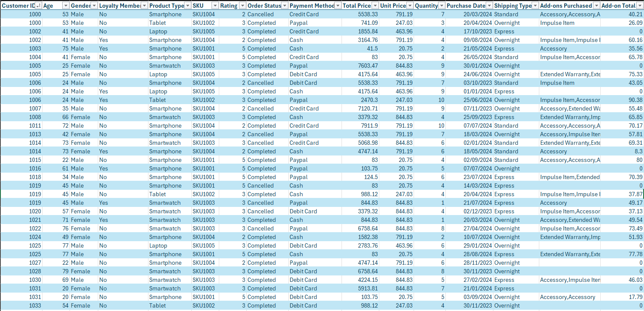
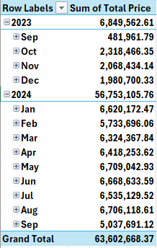
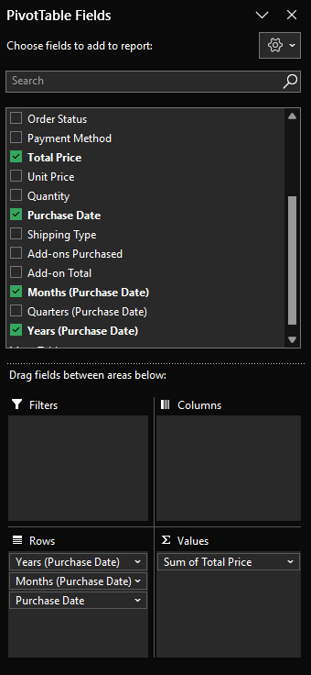
Introducing the Data
The dataset contains sales transaction records for an electronics company over a one-year period.
The data is synthetic and therefore does not represent real-world transactions or actual customer data.
Quick sanity checks with Excel.
Does the data look sensible
Any obvious errors in what's in each column
Make a few quick pivot tables to get a feel for the data.
24 March 2025
Notes:
This dataset contains sales transaction records for an electronics company over a one-year period.
The dataset was presented as a CSV file containing 20000 lines with fields such as customer: age, type of product being ordered, total price, date, etc.
Since it's synthetic data, it doesn’t reflect real-world transactions but should still provide a useful framework for analysis.
Before diving into analysis, I performed some quick sanity checks in Excel looking for any missing values, incorrect data types, or inconsistencies in the dataset.
I also created a handful of pivot tables to get a sense of the data structure and major trends.
This one in particular, takes the sum of total price values for each month and is a good one for finding any dates that are out of place.

Slide 3
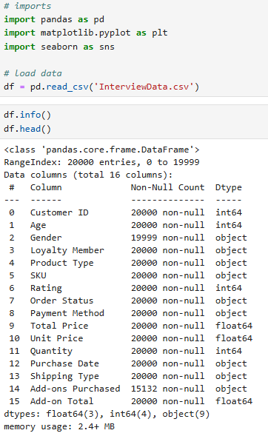
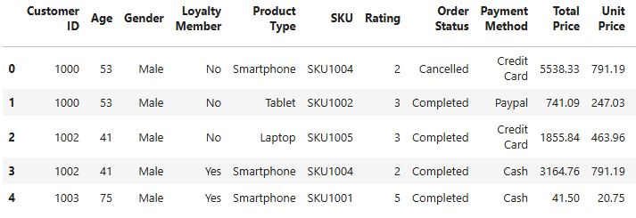
Introducing the Data
Next, I loaded the data into a DataFrame in Python
Like in Excel I check that everything loaded in correctly.
Especially looking for missing values or incorrect data types.
24 March 2025
Notes:
Next, I loaded the dataset into a Python Pandas Dataframe for deeper analysis. I opted to use Jupyter notebooks and python for this investigation as its what I have used the most during my studies.
As with Excel, I checked for missing values and incorrect data types to ensure clean, usable data.
Only one entry had an unexpected NULL value.
There is one customer with gender of NULL, while a non male/female value should be allowed, leaving the field as NULL could cause issues
Removing one line one out of 20000 shouldn't cause a big deal so, I removed it for neatness, dropping just that one line in the Dataframe.
The Add-ons purchased having NULLs is different, Add-on total (which will be zero for non add-on purchases) has no NULL values so could be used for numerical analysis instead.
I've included snippets of code to show some of the steps I've taken.

Slide 4
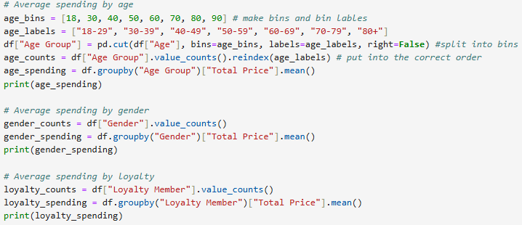
Customer Demographics
What are the key customer demographics?
Do certain types customers spend more than others?
24 March 2025
Notes:
To better understand the sales data, I first looked at customer demographics.
Specifically, I wanted to answer: Do certain types of customers spend more than others?
Here I show splitting out the various ages of customers into age brackets, the youngers customer was 18 so I started the brackets from there and the oldest was 80.
I also created the various series I used for plotting.
A lot of this code is recycled from my university course. And by just changing what I group the data by I can explore few different demographics.

Slide 5
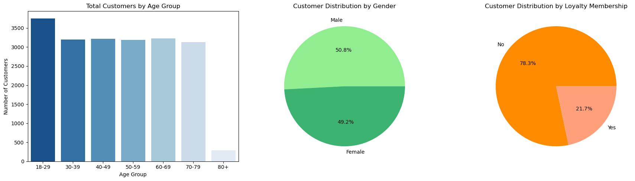
Customer Demographics
24 March 2025
Notes:
Here I show the totals of customers for various demographics, Age, Gender and Loyalty membership.
Here the synthetic nature of dataset can be quite clearly seen, for many of the fields of the dataset values are distributed randomly with a uniform distribution.
For example, every age has an equal chance of appearing in the dataset.
The reason for the higher 18-29 age bracket and the lower 80+ bracket totals is that those brackets are simply different sizes that the others so have more possible values.
According to the notes with the dataset online originally the generated data had exactly 50% counts for both gender and loyalty and were manually changed.
I have since noticed an error on my part, I did not take into account that some customers are repeats and have more than one sale, so they are counted multiple times for these demographics.

Slide 6
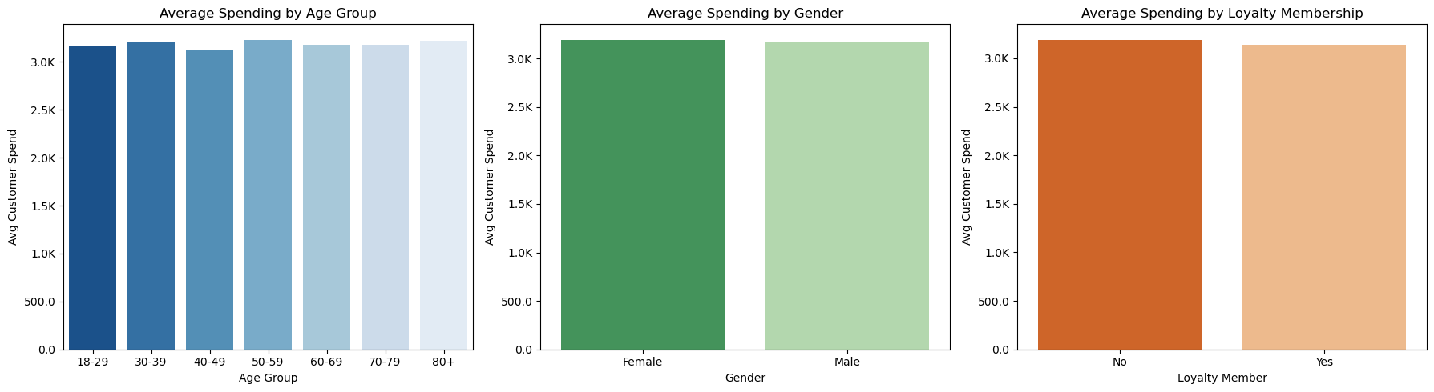
Customer Demographics
24 March 2025
Notes:
And here I show the total cost or spend in an order for each demographic.
Again, you can clearly see the synthetic nature of the data with every demographic having basically the same average spend.
By chance the 50-59 spend the most @ 3231 but theres only about 100 between it and the lowest.

Slide 7
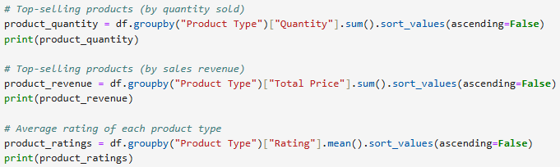
Product Type Stats
What are the top selling products?
Are they also the ones that generate the most revenue?
What are the product ratings like?
24 March 2025
Notes:
Next, I looked at product performance specifically, which product types sell the most, and whether they also generate the most revenue.
I also checked product ratings to see if highly rated products align with high sales.

Slide 8
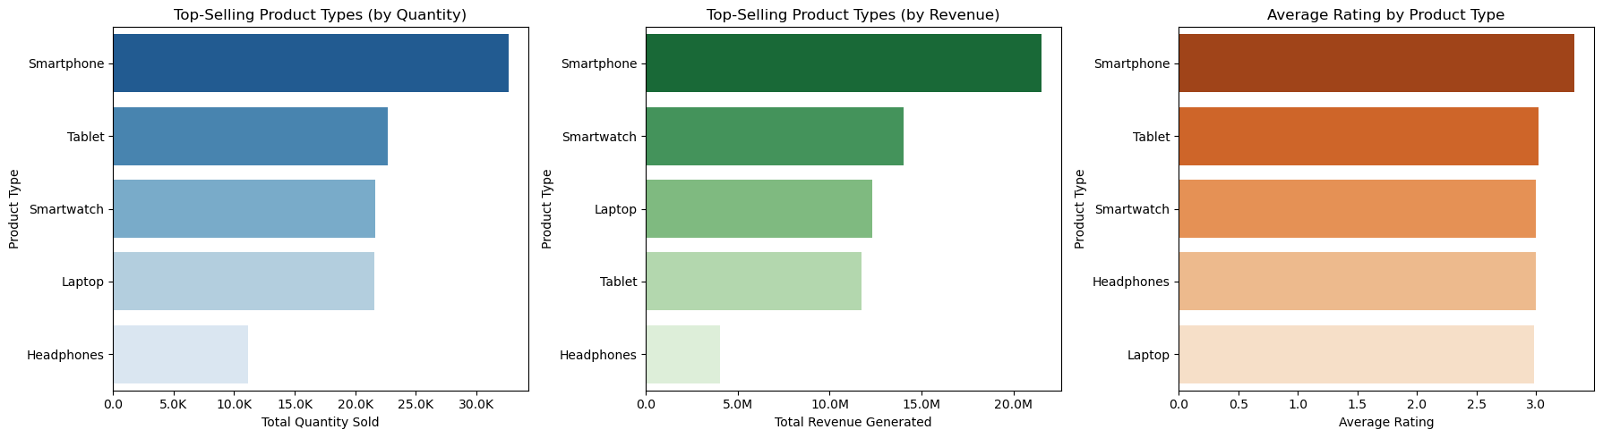
Product Type Stats
24 March 2025
Notes:
Here I have graphs showing the best performing products by Quantity sold, Revenue, and user rating
After the last results I expected to have each again show the same uniform distribution.
But interestingly, Smart phones are the best across the board and headphones the lowest.
Tablets, Smartwatches and Laptops however showing signs of the uniform distribution again, however.
Likely this was by design in the dataset.
For product rating the average for each was 3 (the middle value between 1 to 5 again showing the uniform distribution) but Smart phones are slightly higher.

Slide 9
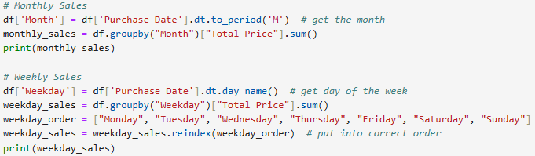
Sales Date Stats
How did sales vary over the year?
When is the busiest time of the year?
How do sales vary over a week?
What is the busiest day of the week?
24 March 2025
Notes:
Moving on to sales trends over time, I next examined how revenue fluctuated across the year and across a week.
You can see here in the code, that im getting the month and day of the week from the Purchase Date
And for the weekdays sorting them into the usual weekday order.

Slide 10
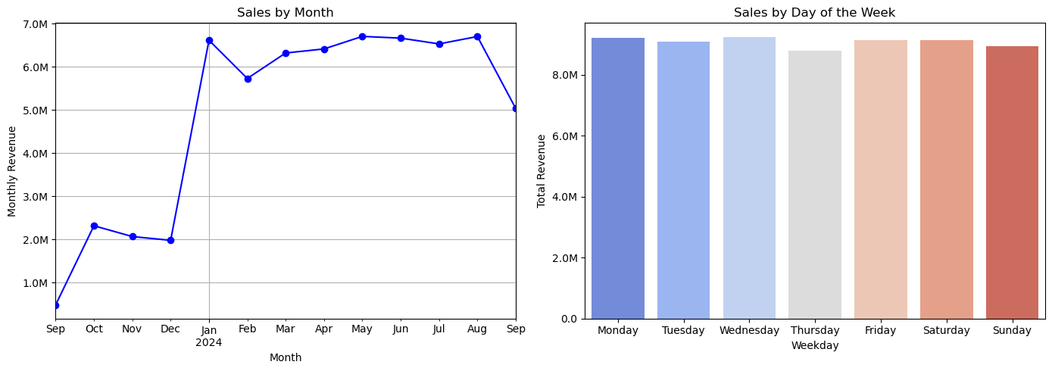
Sales Date Stats
24 March 2025
Notes:
Here you can see the graphs for these.
The data strangely goes from Sep 24th ,2023 to Sep 23rd ,2024, making both September months extra small. Id have expected the data to go from month end to month end as that would be more usual for financial data.
There is interestingly a huge jump in the new year. If this was real data id be wanting to see if this matches with any know events such as the launch of a new store or product.
Sales are then consistent throughout the week, again showing the uniform distribution common in this dataset.

Slide 11
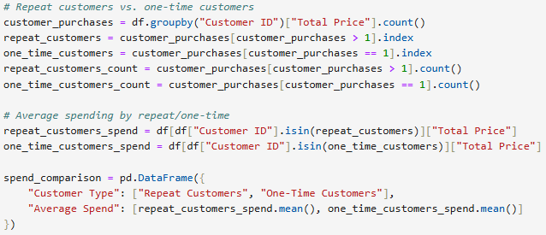
Customer Retention
Do we have repeat customers?
Do they on average spend more?
Who are the top customers?
24 March 2025
Notes:
Finally, this was when I realised the error, that I briefly mentioned before with customer demographics, that there were repeat customers.
So I decided to investigate just how many there were, did they spend more than others and just who were the top customers.

Slide 12
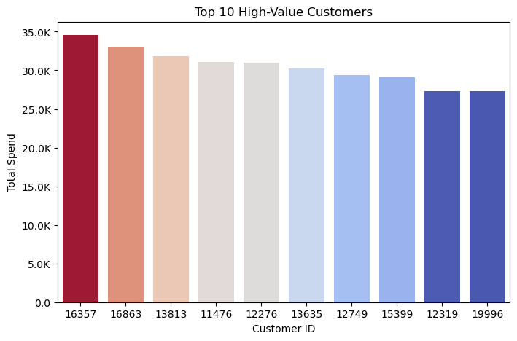
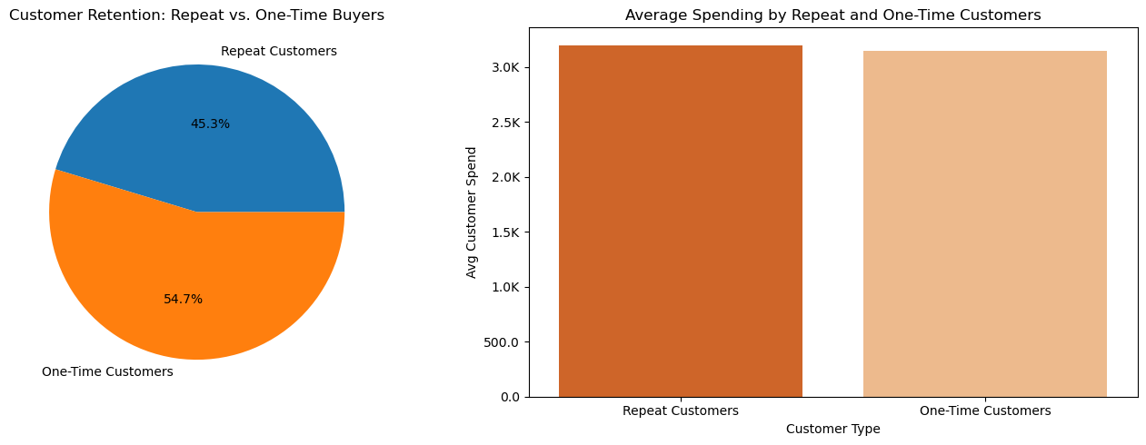
Customer Retention
24 March 2025
Notes:
Here you can see that just under half of all customers had more than one order associated with them, but again due to the uniform distribution of prices in the dataset they didn’t spend more than the other customers.

Slide 13
Possible Future Work
More in-depth customer analytics taking repeat customers into account.
Investigate some of the other fields.
Product prioritisation, which products generate the most revenue per sale?
What caused the huge jump in monthly revenue?
Can we forecast future sales figures?
24 March 2025
Notes:
If I were to continue this work I have a few ideas of what id like to investigate further.
Look into how the repeat customers impact the customer demographics?
Investigate some of the other fields like how many orders were cancelled what were preferred shipping or payment types, and what were the most popular add ons?
Look at which products generated the most revenue per sale?
If the data were real potentially look into what could have caused the jump in sales from January onwards?
And can I forecast future sales figures based on just this year of data?

Slide 14
Thank you for listening.
Emily Wills
24 March 2025

